Slide 1
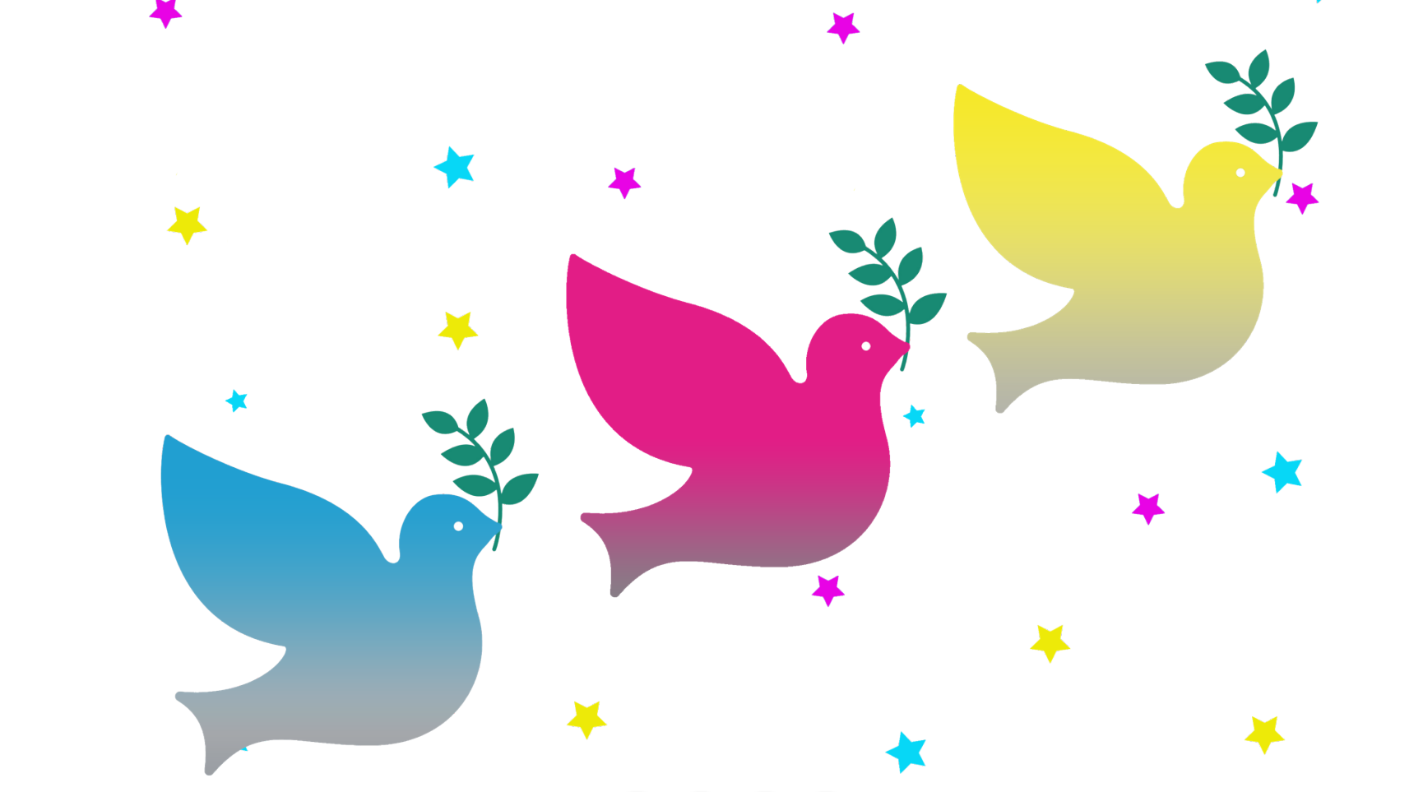

Tri-borough Music Hub
Christmas Festival 2022
CPD

Slide 2

Teaching the Songs – Helpful Tips:
Playing the performance tracks/reading through the lyrics and talking about the songs can be a useful place to start.
You may find it easier to start with teaching the lyrics before teaching the melody.
Call and response is a good way to teach the melody and the rhythm of the music.
If you are not a confident singer, feel free to use the incorporate the performance tracks into your teaching
Once you’ve learnt a song, keep singing it/playing it in class

Slide 3
Teaching the Songs – Warm Ups:
  You can use warm ups that incorporate any combination of the following:
    Physical
    Breathing
    Posture
    Tongue Twisters
    Vocal Range
  Link to KS1 & 2 Warm Ups

Slide 4
Teaching the Songs – The Music:
  There are 4 main songs that we will be learning for the Christmas Festival. Each song will have three choir parts:
    Dona Nobis Parcem
    The Christmas Tree Song
    The Grey Cuckoo
    A Happy New Year Medley
  We will also sing “We Wish You a Merry Christmas”, for which audience participation will be encouraged.
  There will be readings throughout (more information to follow) and we are hoping to have a secondary school solo performance on each day.
  Accompanying resources:
    Physical Resource Booklets
    Digital resource (Audios & Makaton videos)

Slide 5
Teaching the Songs – Choir Parts (Day 1):
CHOIR 1 | CHOIR 2 | CHOIR 3
Brackenbury Primary School | Wormholt Park Primary | George Eliot Primary School
Marlborough Primary School | St Charles Catholic Primary School | St Francis of Assisi Primary School
St Augustine's Primary School | St Mary Abbots CofE Primary School | St Clement & St James CE Primary
All Saints CE Primary School | Wendell Park Primary School | St James and St John
 | St Thomas of Canterbury | St Edward's Catholic Primary School

Slide 6
Teaching the Songs – Choir Parts (Day 2):
CHOIR 1 | CHOIR 2 | CHOIR 3
Sulivan Primary School | ARK Burlington Danes Primary | St Mary's Catholic Primary School
Old Oak Primary School | College Park School | Kensington Primary Academy
Barlby Primary School | Edward Wilson | St. John XXIII
St Joseph's Catholic Primary | Park Walk Primary School | Flora Gardens Primary School
 | Essendine Primary School | St Vincent's Catholic Primary School
 | St Gabriel's CofE Primary School

Slide 7
Key Information:
Support visits (according to availability) | 1st to 27th November
Dress Rehearsal for Festival Performance Day 1 | Monday 5th December, 9:45am – 12pm | Kensington Town Hall Hornton Street, London W6 0QL
Dress Rehearsal for Festival Performance Day 2 | Monday 5th December, 12:30pm – 2:30pm | Kensington Town Hall Hornton Street, London W6 0QL
Festival Performance Day 1 | Tuesday 13th December, 9:30am – 3:30pm Performance time: 2-3pm | Kensington Town Hall Hornton Street, London W6 0QL
Festival Performance Day 2 | Wednesday 14th December, 9:30am – 3:30pm Performance time: 2-3pm | Kensington Town Hall Hornton Street, London W6 0QL

Slide 8

Key Information:
  Support Visits will take place between 1st and 27th November 2022. If you haven’t already done so , please let us know by end of day on Friday 21st October.
  Please send your spreadsheet of required information by end of day on Friday 4th November latest. Do let me know if you have queries about any of the questions as soon as possible.
  We invite schools to run internal Christmas poetry competitions with their students, with the winning students having the opportunity to read their poem at the Christmas Festival. The theme will be ‘Music and Wellbeing’. Please do send through any poems you would like to be considered for a reading by end of day on Monday 28th November.
  Please do keep In touch with the progress of rehearsals, and do email evie.asio-okwalinga@rbkc.gov.uk if you have any questions/queries/comments.

